Slide 1
A few notes of MTurk

Slide 2
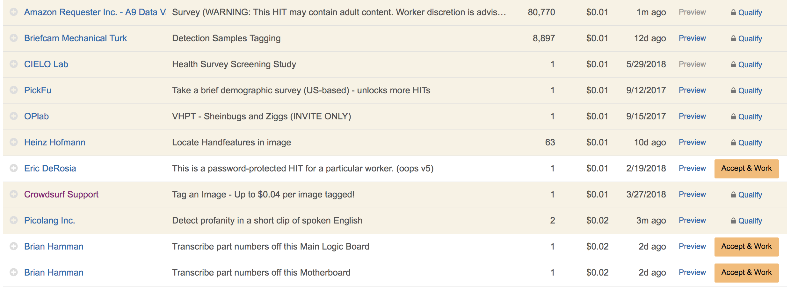
Opportunity: every other kind of HITs

Slide 3
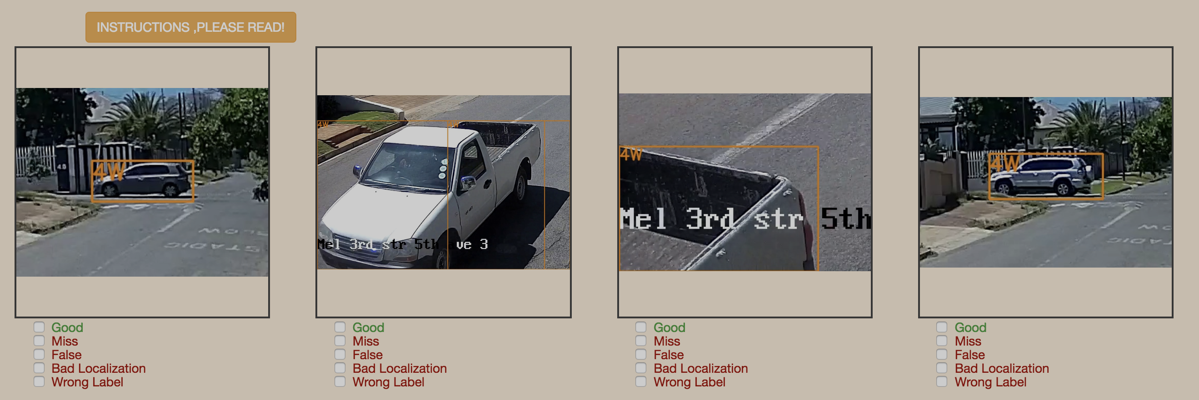
Opportunity: every other kind of HITs

Slide 4
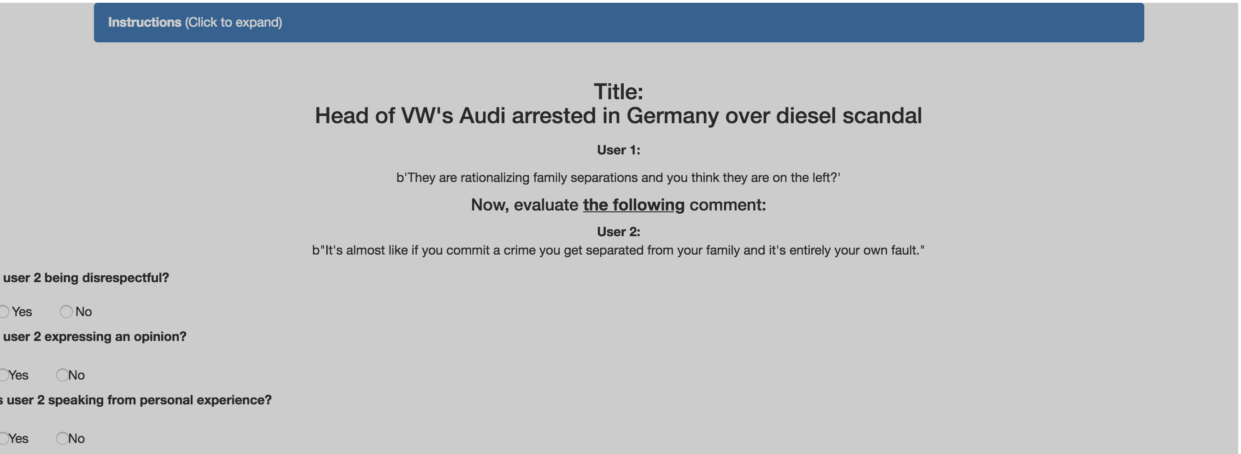
Opportunity: every other kind of HITs

Slide 5
Opportunity: Survey experiment
Survey taker 1
A B1 C
Survey taker 2
A B2 C
Survey taker 3
A B3 C

Slide 6
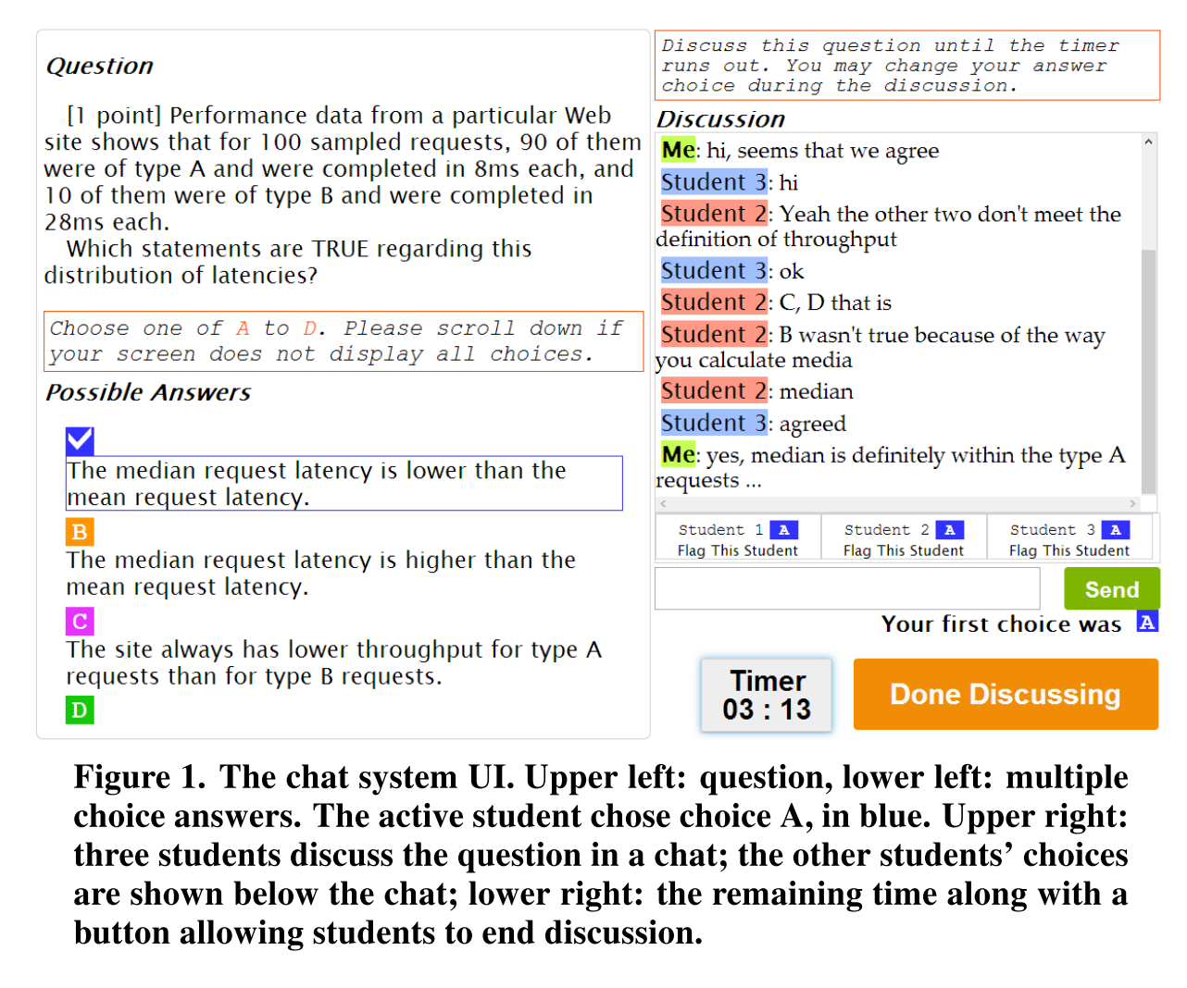
Opportunity: focus groups
Lim, S., Coetzee, D., Hartmann, B., Fox, A., & Hearst, M. A. (2014). Initial experiences with small group discussions in MOOCs. In Proceedings of the first ACM conference on Learning @ Scale conference - L@S ’14 (pp. 151–152). https://doi.org/10.1145/2556325.2567854

Slide 7
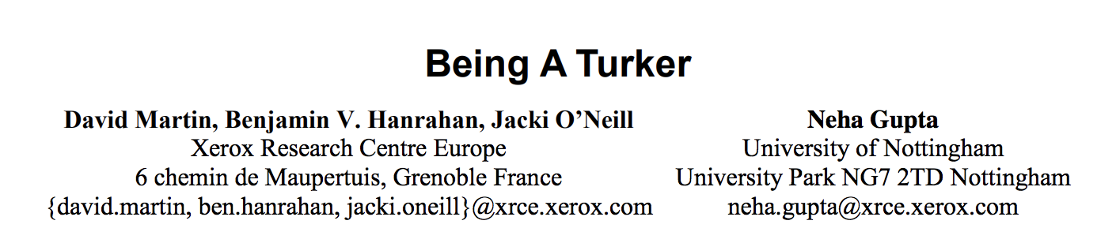
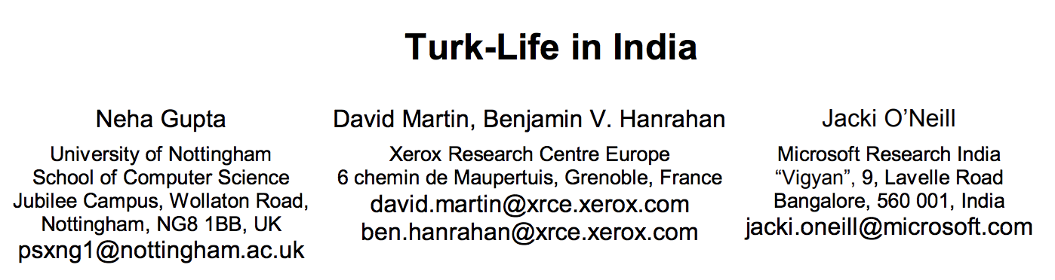
Challenge: Turkers are humans

Slide 9
Turkers as new college students?

